Slide 1
Case 3 | Statistics and Data Science
Liamo Pennimpede

Slide 2
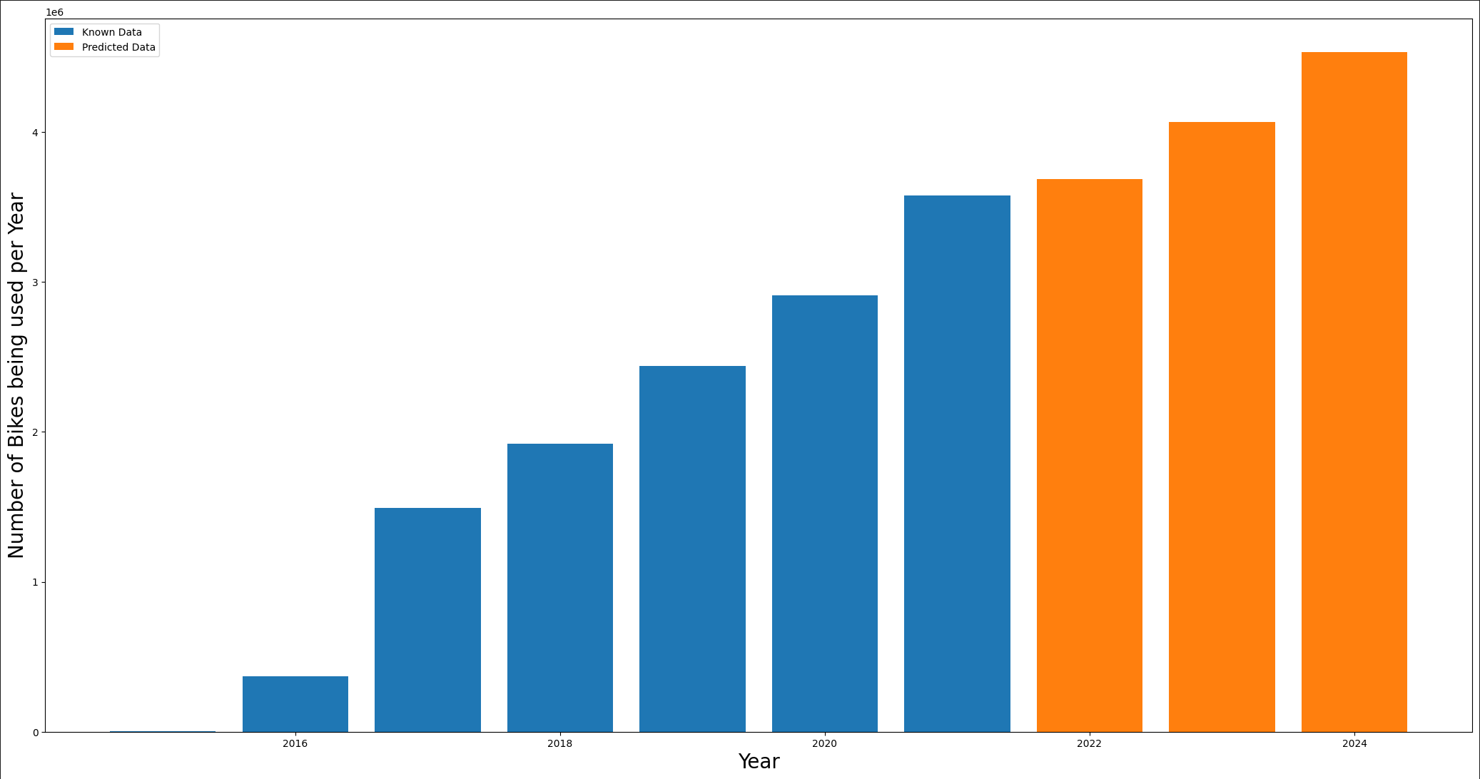
Bike Share Toronto Ridership Analysis
Steps Taken:
Clean the data from excel and format it for simple use
Preprocess the Data to standardize it
Split Data into a training dataset and testing dataset
After achieving a suitable confidence level apply Linear Regression prediction
Source: https://open.toronto.ca/dataset/bike-share-toronto-ridership-data/

Slide 3
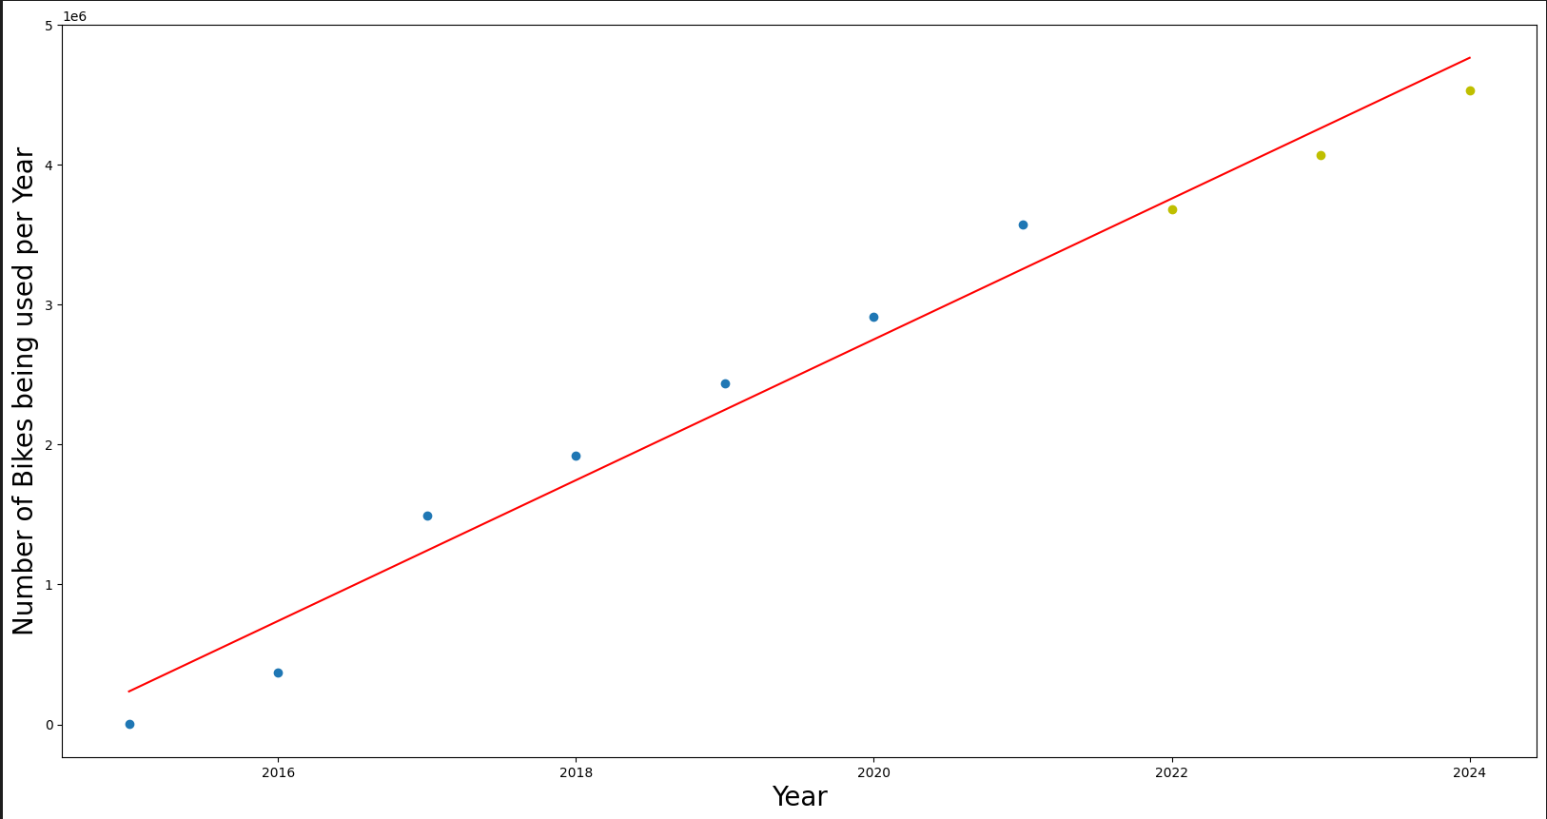
Bike Share Toronto Ridership Analysis
Source: https://open.toronto.ca/dataset/bike-share-toronto-ridership-data/

Slide 4
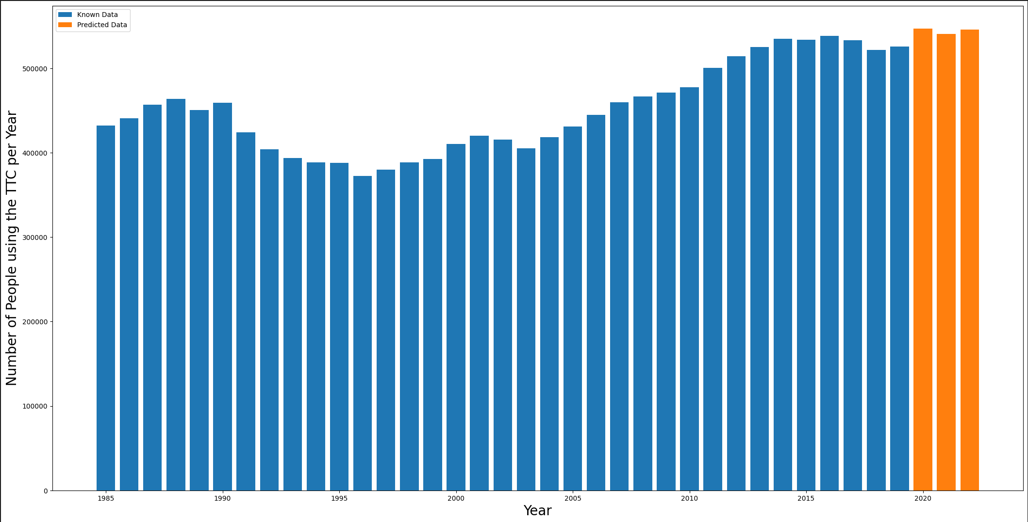
Number of People Using the TTC per year
Steps Taken:
Clean the data from excel and format it for simple use
Preprocess the Data to standardize it
Split Data into a training dataset and testing dataset
After achieving a suitable confidence level apply Linear Regression prediction
Source: https://open.toronto.ca/dataset/ttc-ridership-analysis/

